Slide 1
Gaussian Naive Bayes

Slide 2
Gaussian Naïve Bayes
Probabilistic classifier for continuous data
Assumes Gaussian distribution(Normal Distribution)
Continuous features are modeled using Gaussian curves (bell curves).
Uses Bayes Theorem

Slide 3
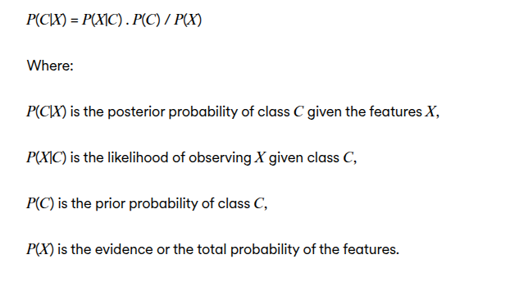
Bayes Theorem
Choose class with maximum posterior

Slide 4
Why Gaussian?
Features are numerical
Each feature follows Normal distribution
Data is represented using Gaussian probability distribution for continuous features.

Slide 5
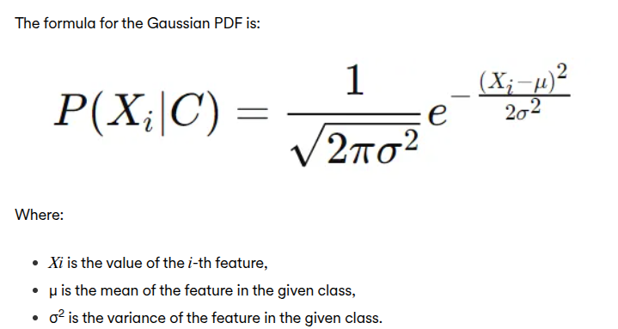
Gaussian Probability Density Function
The Gaussian (normal) distribution is a symmetric probability distribution characterized by its bell-shaped curve.
By assuming that the feature values follow a Gaussian distribution, the algorithm can calculate the likelihood of a feature value belonging to a given class using the Gaussian probability density function (PDF).

Slide 6
Algorithm Steps
1. Compute class priors
2. Compute mean & variance
3. Compute likelihood
4. Choose max class

Slide 7
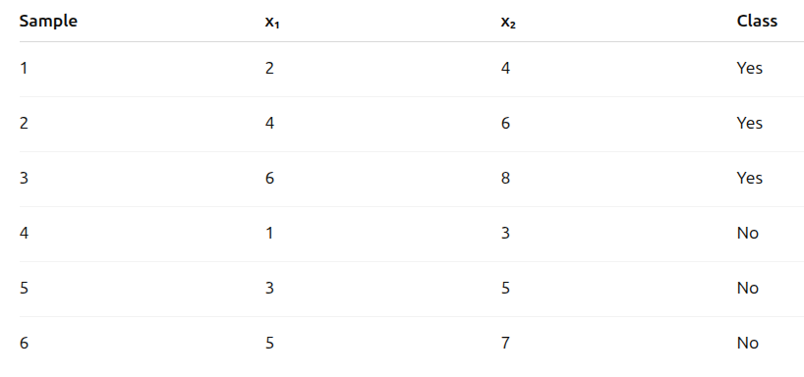
Dataset

Slide 8
Classify the new sample using Gaussian Naive Bayes
x = (4, 6)

Slide 9
Step 1: Prior Probabilities
Total samples = 6
P(Yes) = 3/6 = 0.5
P(No) = 3/6 = 0.5

Slide 10
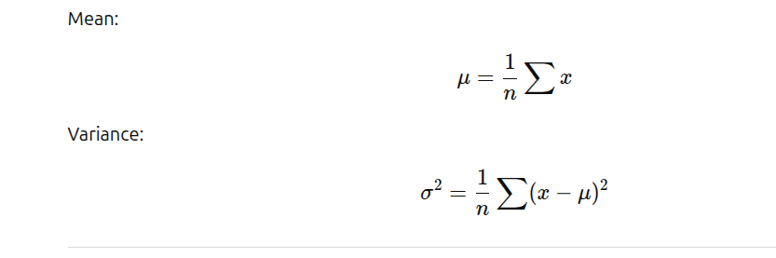
Step 2: Mean and Variance

Slide 11
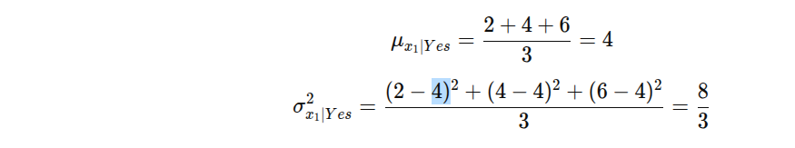
Gaussian Parameters Class =YES
Feature x1: mean = 4, variance = 8/3
Feature x2: mean = 6, variance = 8/3

Slide 12
Gaussian Parameters Class = NO
Feature x1: mean = 3, variance = 8/3
Feature x2: mean = 5, variance = 8/3

Slide 13
Step 3: Gaussian Probability Formula

Slide 14
Gaussian Denominator Calculation
1/√(2πσ²) = 1/√(2*3.14*2.66)
=0.2450
Same denominator for all classes and features (Because the variance is common in this data)

Slide 15
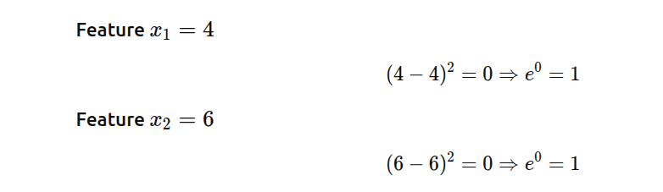
Step 4: Likelihood for YES
P(X|Yes)=(0.245 *1)*(0.245*1)=0.0600

Slide 16
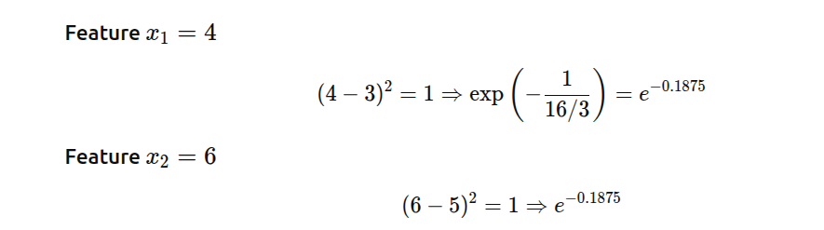
Likelihood for NO
E^(−0.1875)=0.829
P(X|NO)=(0.245*0.829)*(0.245*0.829)
=0.203 * 0.203
=0.0412

Slide 17
Step 5: Posterior Probability Comparison
P(Yes|x) = 0.5 × 0.0600 = 0.03
P(No|x) = 0.5 × 0.0412=0.020

Slide 18
Final Prediction
P(Yes|x) > P(No|x)
Predicted Class = YES
Class with highest posterior probability is selected

